Slide 1
What’s New in Asset Management 2022, 2024 & 2025

Slide 2
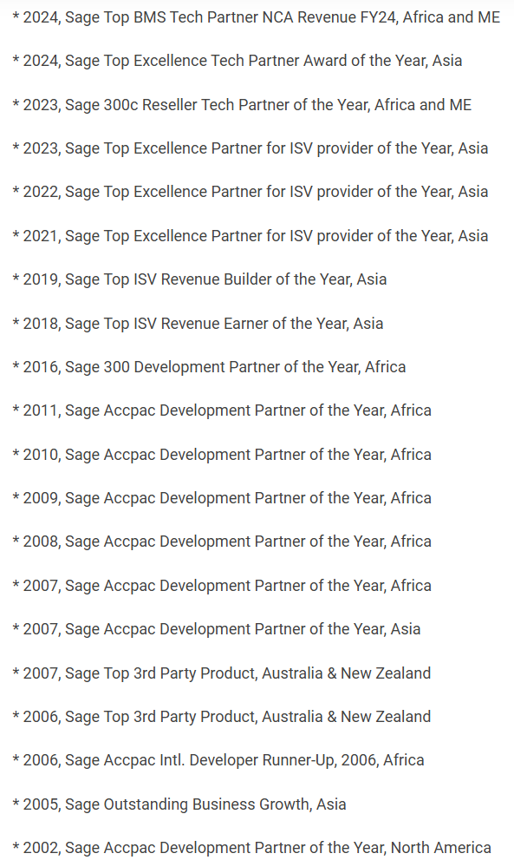
About Norming
A Key ISV of Sage
20+ years with sage
700+ business partners
6000+ active clients
Our Awards
Won a number of awards from sage
Our Products
Norming Resource Manager
Norming Asset Management
Norming Security Suite
Norming HRMS
Notes:
We’re part of Sage ecosystem since 2000, and have been serving Sage customer for more than 20 years.

Slide 3
Keeps getting better - upgrade to the newest version today!
2022
2024
2025
Customizable assets inquiry for smarter analysis
Easily group and view assets using predefined criterion in folders. Export inquiry result for reporting and deeper analysis
Improve integration, performance and stability
Enhanced compatibility with Sage 300 (v2019 - 2025), along with performance and stability improvements to the Web Screen version.
Continue enhancing functionalities
Further improvements to Acquisition, Asset Split, WIP Transfer and Lease Contract features.
Allow to upload multiple attachments for assets
Upload unlimited supporting documents to maintain comprehensive asset records
More functionalities available in Web Screen
Provide the 'Barcode Download' function in the Web Screen
Improve license management
Activate license across multiple companies with a single click. Receive advance warnings before subscription expiry to avoid interruptions
Easily track and update assets’ status with mobile app
Use the Norming eTracker App to scan and update asset status by asset category – anytime and anywhere
Enhance depreciation projection and reversal capabilities
Support more targeted depreciation projections using new filtering options. Now supports reversal of after-disposal depreciation entries

Slide 4
What’s New in Asset Management 2022

Slide 5
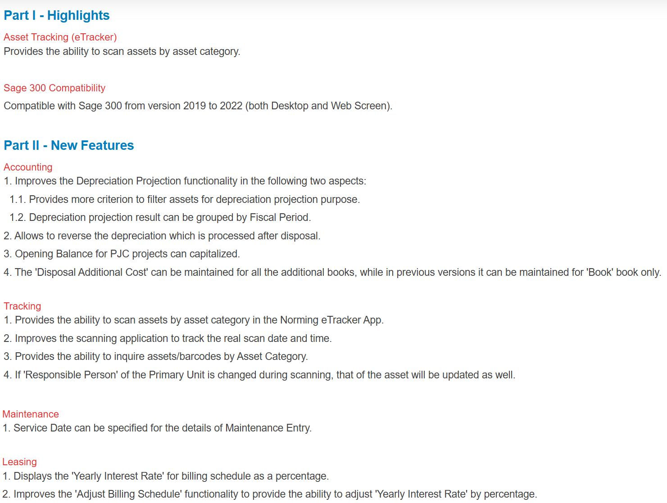

Slide 6
What’s New in Asset Management 2024

Slide 7
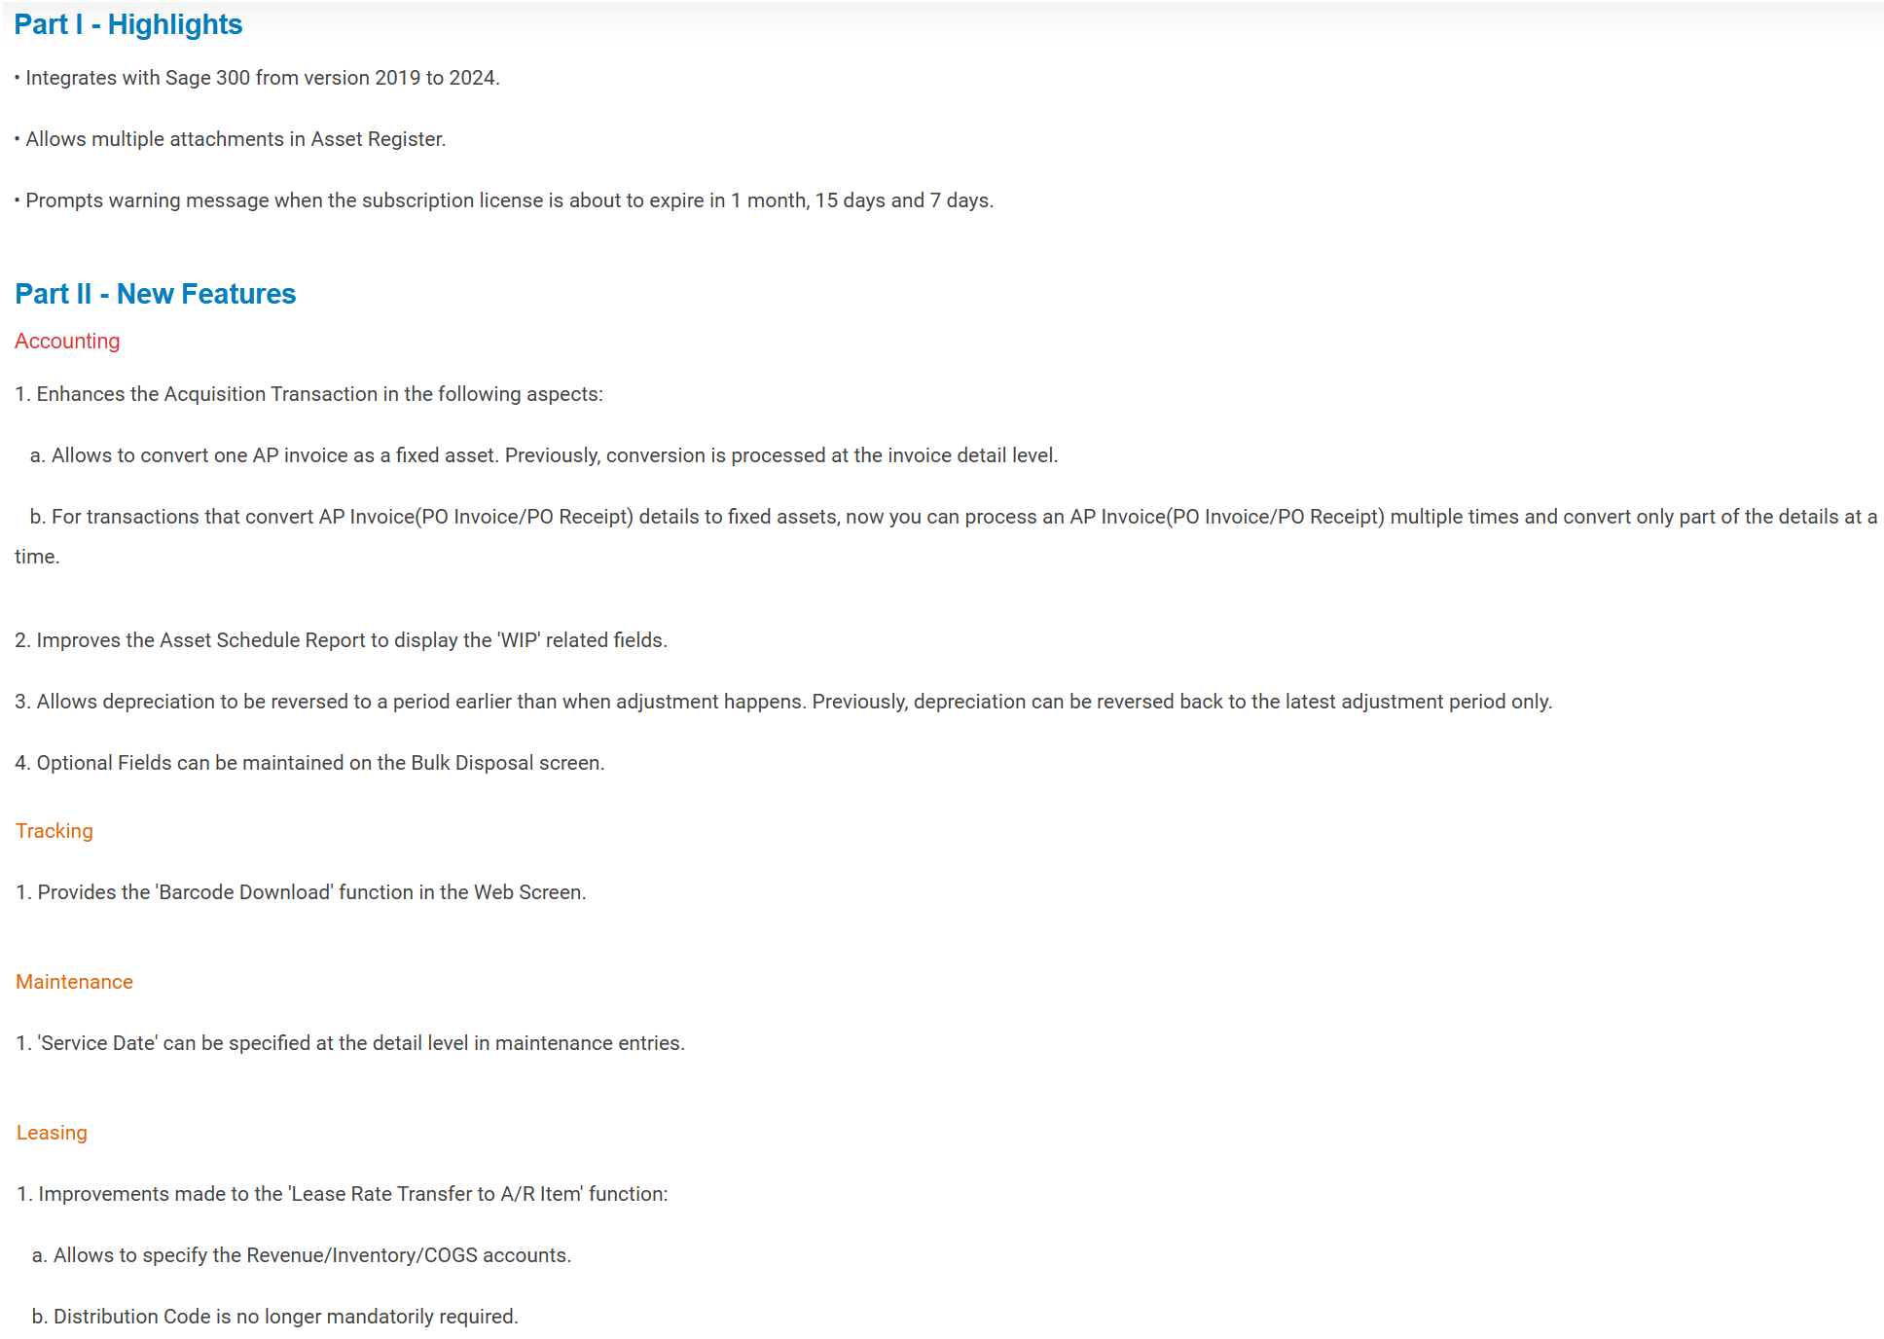

Slide 8
What’s New in Asset Management 2025

Slide 9
Part I - Highlight
Customizable assets inquiry for smarter analysis
Easy to group and display assets with predefined-criterion in separate folders. Inquiry result can be exported for further analysis
Part II - New Features
Improve integration, performance and stability
Integrate with Sage 300 from version 2019 to 2025. Improve performance and stability of Web Screen version
Acquisition
Provides the ability to select and dis-select all when converting PJC projects to fixed assets.
Split
Units’ location and description can be copied to split-to assets.
WIP Transfer
Allows to preview the to-be-transferred assets, where you can remove the WIP/Assets you don’t want to convert.
Lease Contract
Rename the ‘Start Lease Contracts’ to ‘Start/Complete Lease Contracts’, where you can start or complete asset lines in selected lease contracts.

Slide 10
Thank You !

