Slide 1

Webinar: eProcurement &
AP Automation for Sage 300
February 9, 2023

Slide 2
Agenda
Company Background
Solution Overview
Live Demo

Slide 3
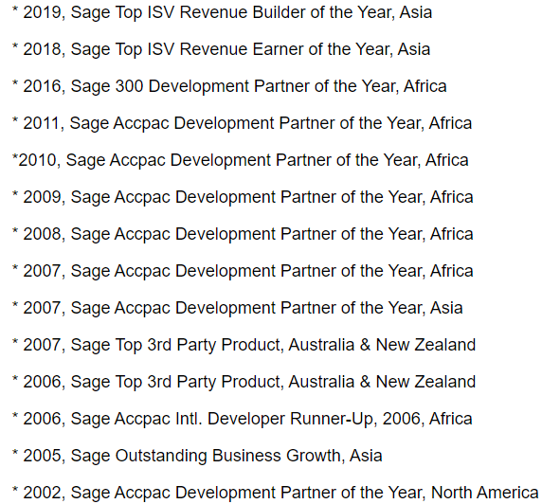
About Norming
A Key ISV of Sage
20+ years with sage
900+ business partners
10000+ clients
Our Awards
Won a number of awards from sage
Our Products
Norming Resource Manager
Norming Asset Management
Norming PSA
Norming HRMS
Notes:
We’re part of Sage ecosystem since 2000, and have been serving Sage customer for more than 20 years.

Slide 4






Resource Manager - Functions
Purchase Req.
PO Receipt
PO Invoice
AP Invoice
Procure to Pay
AP Payment
Travel Req.
Cash Adv.
Exp. Report
Travel n Expense
Exp. Payment
Timesheet
Time Clock
Leave
Overtime
Time Mgmt.
Scheduling
Planning
LEM Report
Project Mgmt.
Sales Quote
Item Usage Req.
Custom Req.
Other
Functions
Custom Report
Manager Console
Notes:
The eProcurement function is part of a product – called Norming Resource Manager. Before introducing the eProcurement, I would like to brief the Resource Manager to you guys firstly.

Slide 5
Resource Manager – NEW Function
Optical Character Recognition
(OCR)
AP Automation
Notes:
In the latest version of Resource Manager, we got a new function – AP Automation, which uses the Optical Character Recognition technology to auto the capturing information from e-copy of your AP invoice.

Slide 6
Employee Portal for Sage
Employee Portal
CRM
Finance
(Sage)
Sage
300
Employee Portal
Backend Application
？

Slide 7
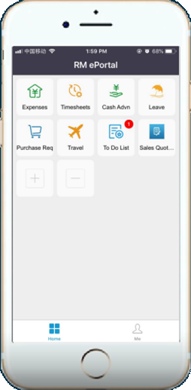
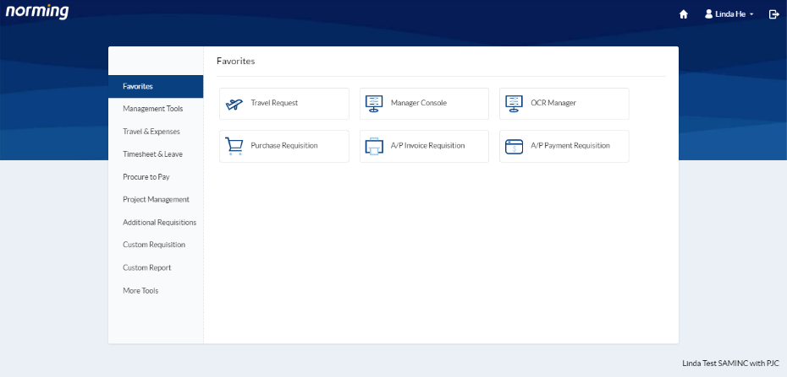
Employee Portal

Slide 8
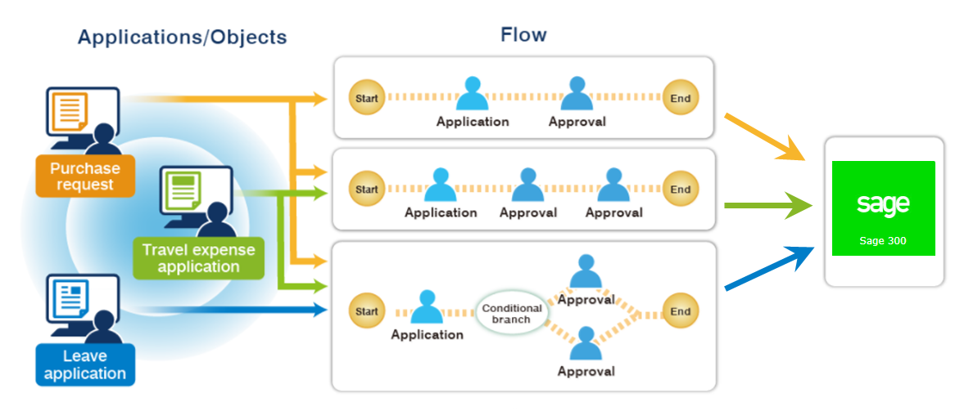
Workflow

Slide 9
eProcurement (Purchase Requisition)
Comprehensive Approval setup and workflow
Documents / Images attachment
Online quote request
Costs control check
Notes:
Local OCR supplier – Intsig
eProcurement

Slide 10

Live Demo

Slide 11
Demo – Purchase Requisition(eProcurement)
Demo – eProcurement (Purchase Requisition)
Raising
Requirement
Getting
Quotes
Purchasing
Goods
Goods Receiving
& Invoicing
PR
PR+PO
PO Request
Staff
(Linda - 100030)
Manager
(Monica - 100020)
Purchaser
(Purchaser 100040)
General Mgr.
(100070)
> $10,000
Finance Mgr.
(100010)
<= $10,000
Approval Process

Slide 12
Demo – Issue PO to Supplier
PO
Request
Sage 300
Purchase Order
Supplier
Goods receiving
& Invoicing
These processes can be done
manually or AUTOMATED!!
Notes:
Now the PO request has been fully approved. So you might have the following two questions:
1. Has the formal purchase order been generated?
2. How to send the order to supplier?

Slide 13
…..in the past, AP Invoices captured via
Manual entries
either through Employee Portal or Sage 300 application.
OR
Import invoices
Import the invoices through Sage 300 application.
Notes:
Local OCR supplier - Intsig

Slide 14

AP invoice capturing situation
86% of SMEs are manually entering invoice data
71% of organisations claim manual data entry & inefﬁcient processes as the top pain point
“41% of 1,100 ﬁnance professionals blame manual data inputting for inaccurate ﬁnancials”
Notes:
What’s the status of AP capturing process nowadays.
For most of the companies, the AP is still paper-based
The biggest issue associated with them is lost invoices, with time-consuming data entry coming second and paper invoices coming third. An average of 40% of invoices are still arriving on paper.
These problems are intrinsically linked to paper-based systems. This has increased overtime for 77% of respondents as the approval process becomes more complex and lengthy.

Slide 15

Accountants work an extra day each week
1 in 10 accountants works seven days a week
34% consider quitting once per week or more
47% take work home every week
Notes:
The pandemic has in most cases disrupted the work/life balance of finance teams for the worse.
This has had major implications for their quality of life. A heavy workload has negatively impacted the work life balance

Slide 16
The cost of manually processing invoices is high
For example, Company A processes 350 invoices/per month
One AP Assistant (Hourly Rate: USD 15 per hour)
$2,640 /month in salary payout
Processing 350
Invoices per month
$7.50 per Invoice
Notes:
For which a company needs to pay $7.50 per invoice. It is a happy problem however as one invoice deems as sales transaction. The more the merrier.

Slide 17
Reduce cost by replacing paper and inefﬁcient processes
The average cost to process a single invoice can be up to $8
Automation can reduce the cost by 60%
Average cost coming down to $3 or less.
AP Automation and Digitalization
Notes:
Accounting teams have faced enormous challenges and seen how they work change dramatically.
Those who had automated their AP processes saw the best outcomes regarding productivity, security, cost savings, employee morale, and more.
This has led to the vast majority of companies prioritising investment in the process automation of their AP processes, while some still need to be more willing to do so.
Automation enables remote work, which makes YOUR employees happier and more able to focus on work that adds value as manual processes are eliminated.

Slide 18

AP Automation
Norming Resource Manager
for Sage 300

Slide 19
…. and now with
OCR Technology
AP invoices are captured automatically!
Notes:
Local OCR supplier - Intsig

Slide 20
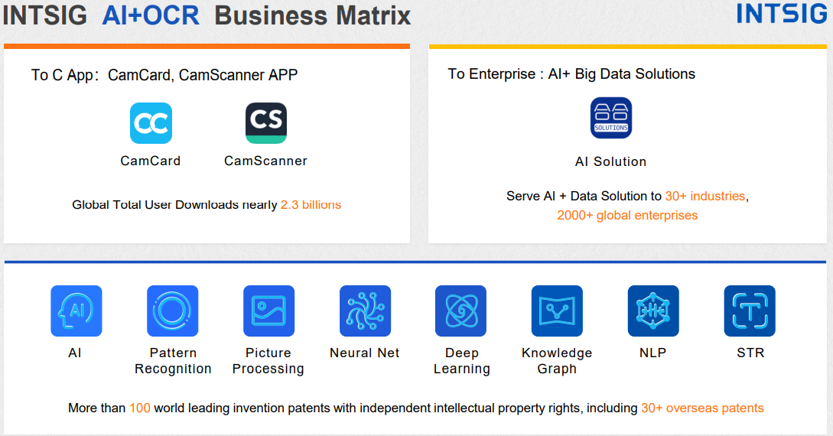
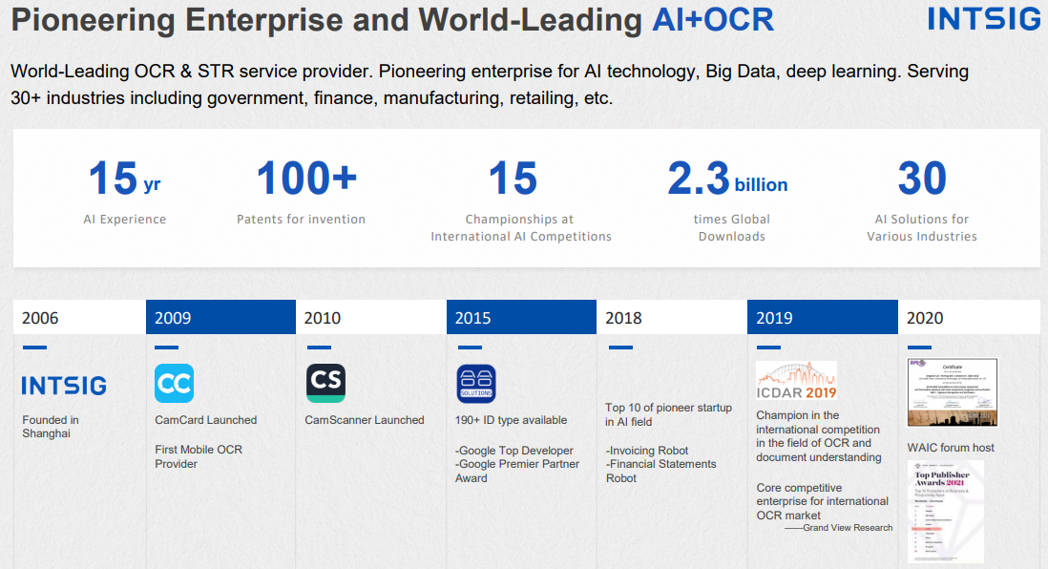
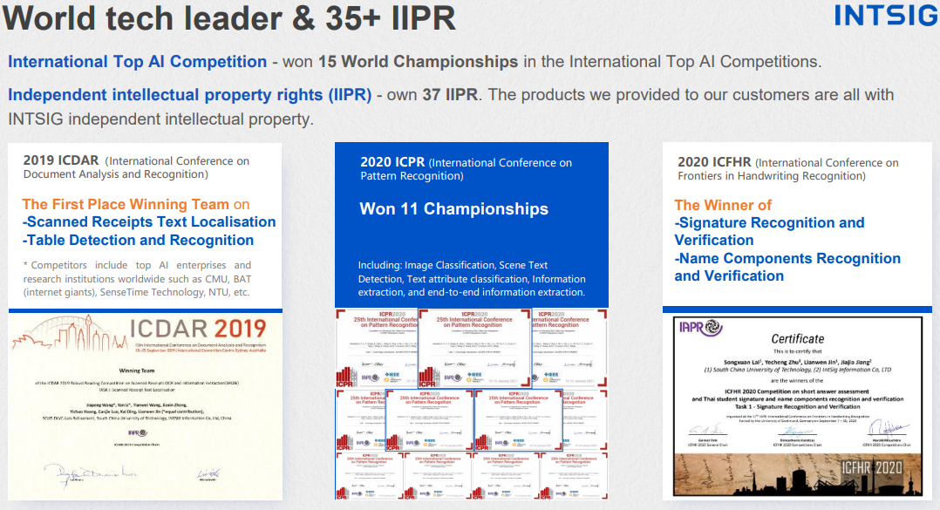
About IntSig

Slide 21












































Served 30+ Industries
Banks
Automobile
Insurances
E-Payment
Notes:
以大金融类应用为例，我们的代表性客户包括招商银行、浦发银行、上海大众、平安保险、三星、支付宝等知名企业

Slide 22
Live Demo

Slide 23
Benefits of AP Automation
Reduce staff time in data entry
Reduce unnecessary data entry errors
Staff can channel their time on other productive activities
Notes:
Local OCR supplier - Intsig

Slide 24

Let’s talk about automation.
Are you ready to mitigate risk, improve AP spend visibility, and revolutionise your company’s productivity?
Email info.asia@sage.com Or Contact your partner
Notes:
With our automation solution add-on for Sage 300, you can approve invoices and pay vendors remotely while drastically reducing your AP costs.
please connect with us or speak with your partner
automation can solve many of the pain points organizations face and bring huge savings.

